Slide 1
hacking
the
micro:bit
Notes:
This is a relatively new hardware platform - a tiny board (a bit like the raspberry pi) but
with bluetooth, compass, tiny display, accelerometer.

Slide 2
if you could make anything…
Notes:
This is a relatively new hardware platform - a tiny board (a bit like the raspberry pi) but
with bluetooth, compass, tiny display, accelerometer.

Slide 3
what would you make?
Notes:
This is a relatively new hardware platform - a tiny board (a bit like the raspberry pi) but
with bluetooth, compass, tiny display, accelerometer.

Slide 4
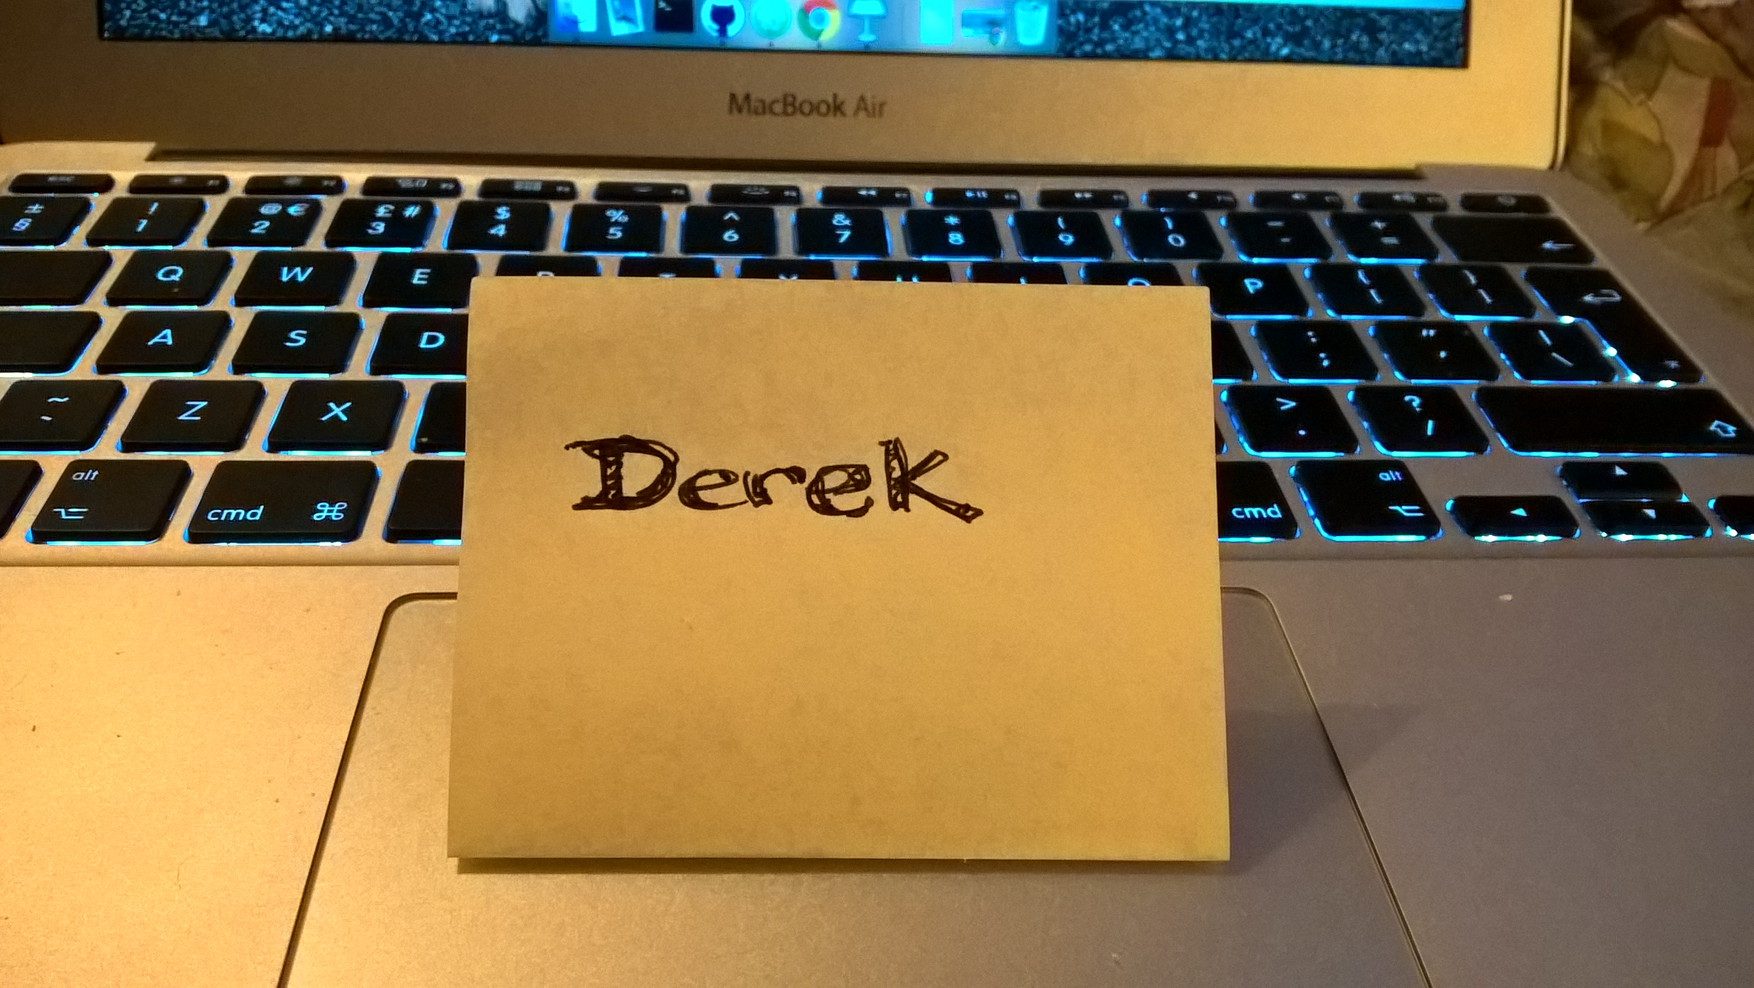

Slide 5
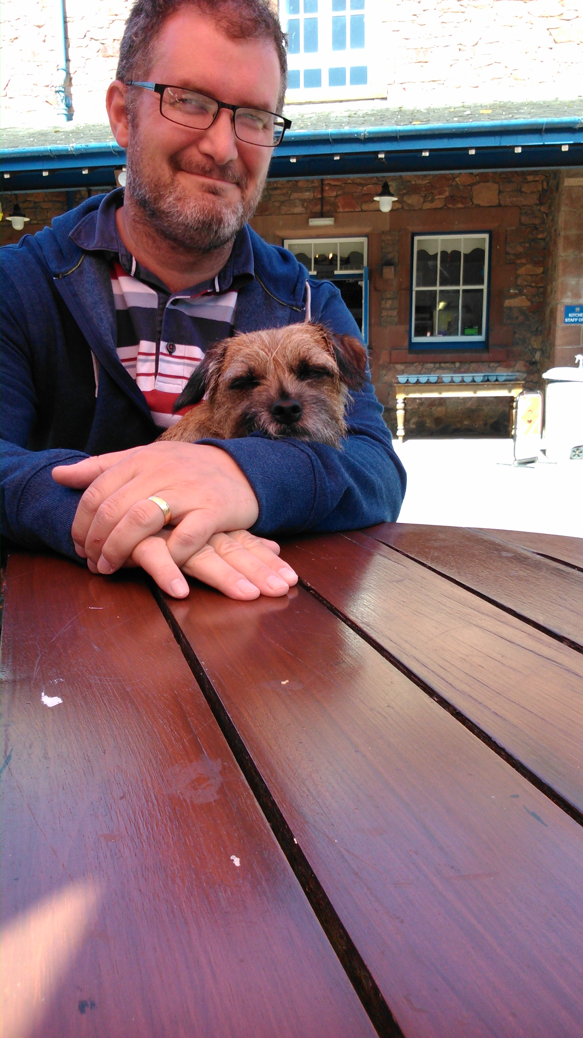
Derek Graham
@deejaygraham
Notes:
My name is Derek Graham and I have been writing software for the last 25 years…

Slide 6
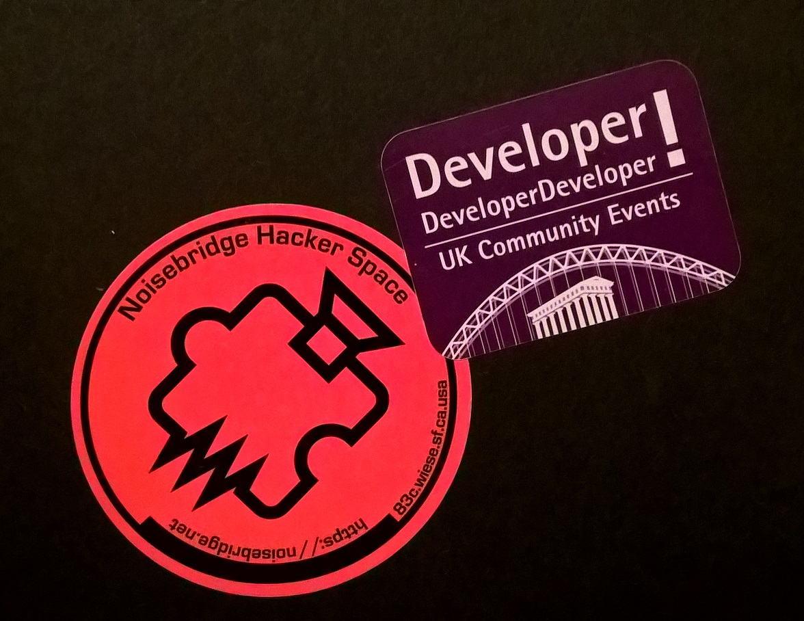
Notes:
lots of different industries and different businesses - consulting, managing teams of software professionals, and sometimes writing code myself.

Slide 7
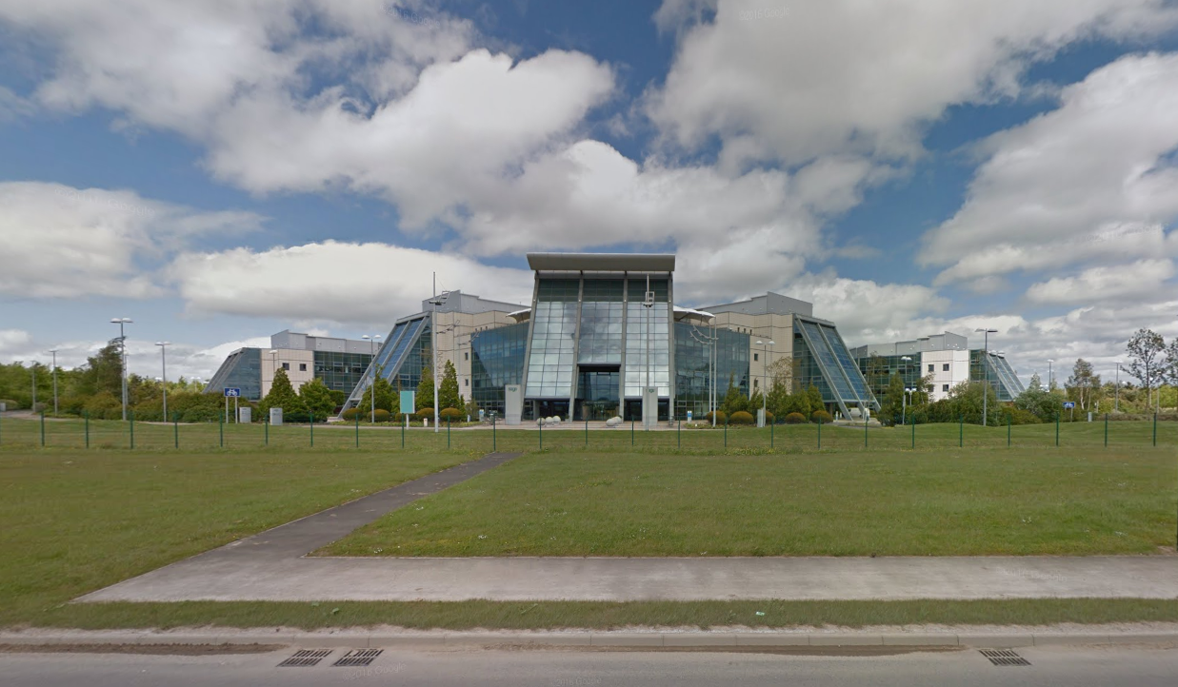
Notes:
I’m a principal developer at Sage in Gosforth. spaceship qualities of the building, plus it has lots of clouds and I mainly work on cloud infrastructure for our online products.

Slide 8

Notes:
I realise you probably all know each other but I’d like to just go around the room and introduce yourself, how you are feeling about being here and try to give me a sense of what your current experience level is and what you want to get out of this afternoon.

Slide 9
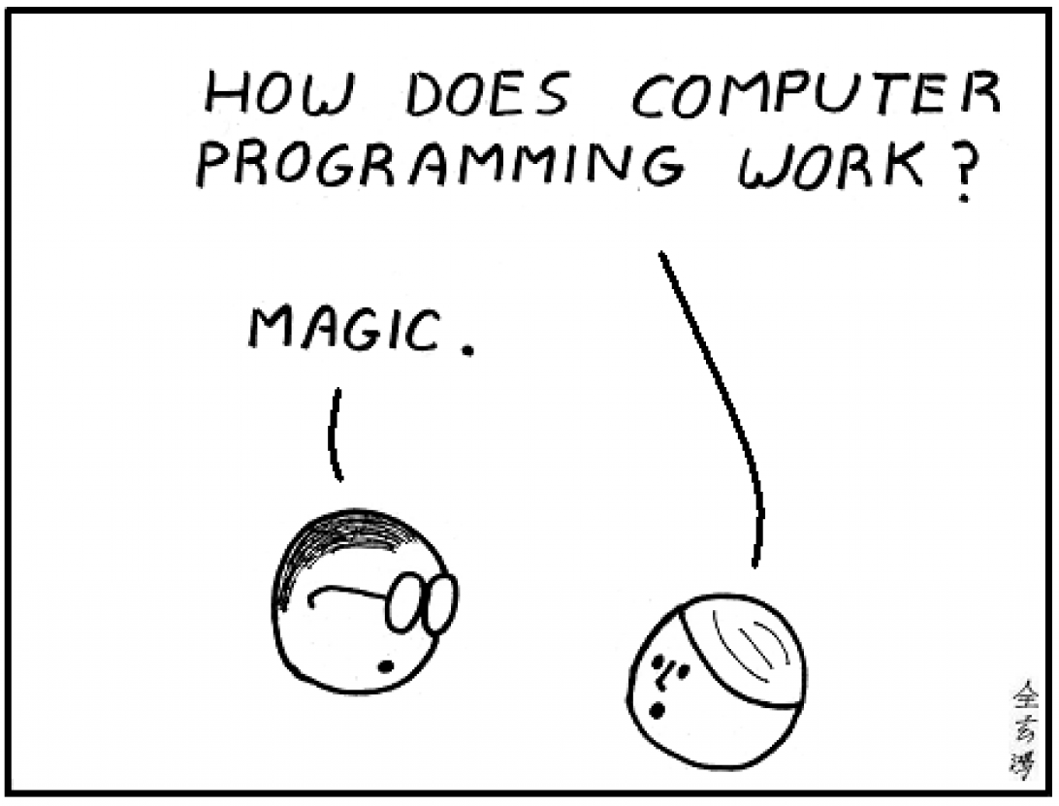

Slide 10
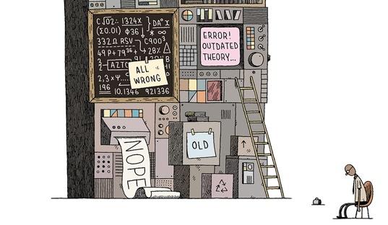
Notes:
No one will shout at you for getting something wrong. By making those mistakes you will get a better understanding of what is going on inside the mind of the computer and if something goes wrong it's not the end of the world, no one will die and no one will be eaten.
It is normal for some of this to hurt your head to begin with but struggling with some of these concepts isn't anything to be frightened of but rather embraced. Programming (and understanding what is going on inside a computer) is a skill like any other. You don't have to be special to learn how to do it but it does take a little bit of time and effort to get used to applying that skill.
Most of the work is going to be inside your head, not typing keys on the keyboard.
It really is about ideas and imagination. It's easier than you think and it's also more fun than you think.

Slide 11
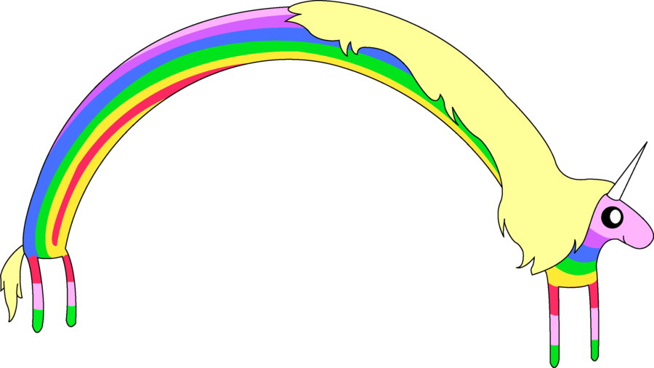
FUN!
Notes:
adventure time unicorns

Slide 12
You can't break anything,
extra typing is the
worst thing
that can happen.
Notes:
and the worst thing that can happen is that we have to scrap your program and type it in again.

Slide 13
What is the microbit?
What is Python?
Group exercises
Pairs (or threes) challenge
Retrospective
Team challenge
Retrospective

Slide 14
Make a game for another team to play
Build the game in chunks and test it progressively
Demonstrate the game
Swap games

Slide 15
micro:bit?
Notes:
This is a relatively new hardware platform - a tiny board (a bit like the raspberry pi) but
with bluetooth, compass, tiny display, accelerometer.

Slide 16


Slide 17
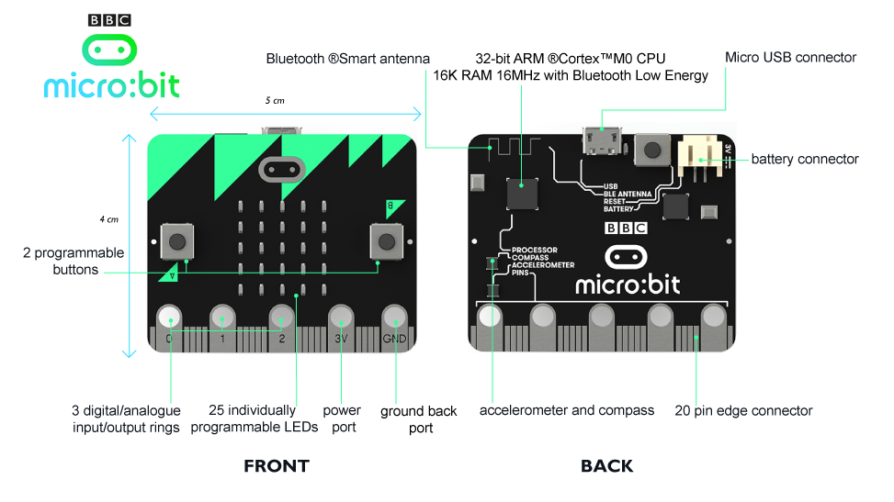
Notes:
This is what it looks like. Buttons and display on the front. Reset button and connector port on the back

Slide 18
A “Real” Machine
Tiny computer
Cheap & Robust
Choice of programming languages
USB or battery powered
Easy to get started

Slide 19
Simple &
Creative &
Complicated

Slide 20
“Computer science is no more about computers than astronomy is about telescopes."
– Edsger Dijkstra

Slide 21
Notes:
Project lead, knitted memory, prevented crash.

Slide 22
More powerful than
the Apollo 11
computers

Slide 23
Accelerometer
Display
Digital IO
Buttons
Radio

Slide 24
python?
Notes:
This is a relatively new hardware platform - a tiny board (a bit like the raspberry pi) but
with bluetooth, compass, tiny display, accelerometer.

Slide 27
python
Beginner friendly
Text-based
Simple syntax
Interpreted

Slide 28
micro python
Lighter
Lower memory
micro:bit-specific functions

Slide 29
micro punctuation
Punctuation
Indenting
Spacing
Spelling

Slide 30
http://codewith.mu
Notes:
This is the special editor we will use. It is designed specifically to work with the micro bit and understands how to download programs to it.

Slide 31
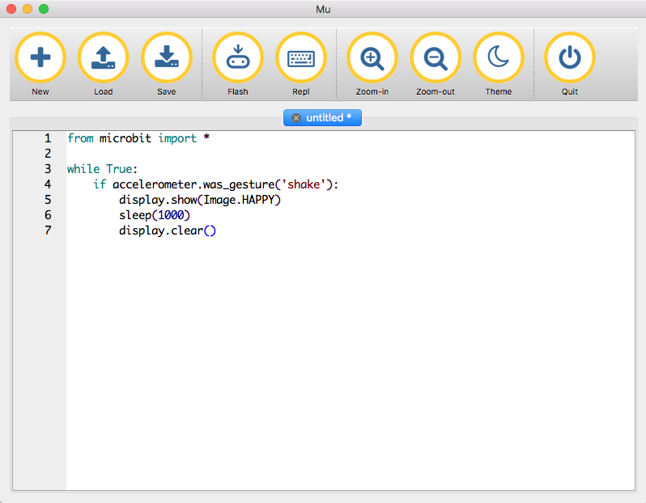
Notes:
Flash button is most important. Downloads program to device. Watch yellow light blink while that happens. The program will start to run. Or will show an error if it can’t make sense of the program.

Slide 32
micro:bit & python
Dedicated processing
Runs one program at a time - yours
Runs code (mostly) top to bottom
Does what you say, not what you think you said
Easy (easier) to reason about
Easier to debug when things go wrong

Slide 33
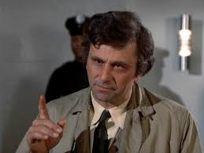
Errors
Python is interpreted
Errors shown one by one
Errors will scroll across the screen
(Can be) hard to read on device
Write them down (if you can)
Use the Reset button on the back
Notes:
microbit errors will scroll across the screen. they can be a bit difficult to read but if you lose the thread of what it’s trying to tell you, you can hit the reset button and it will try again.

Slide 35
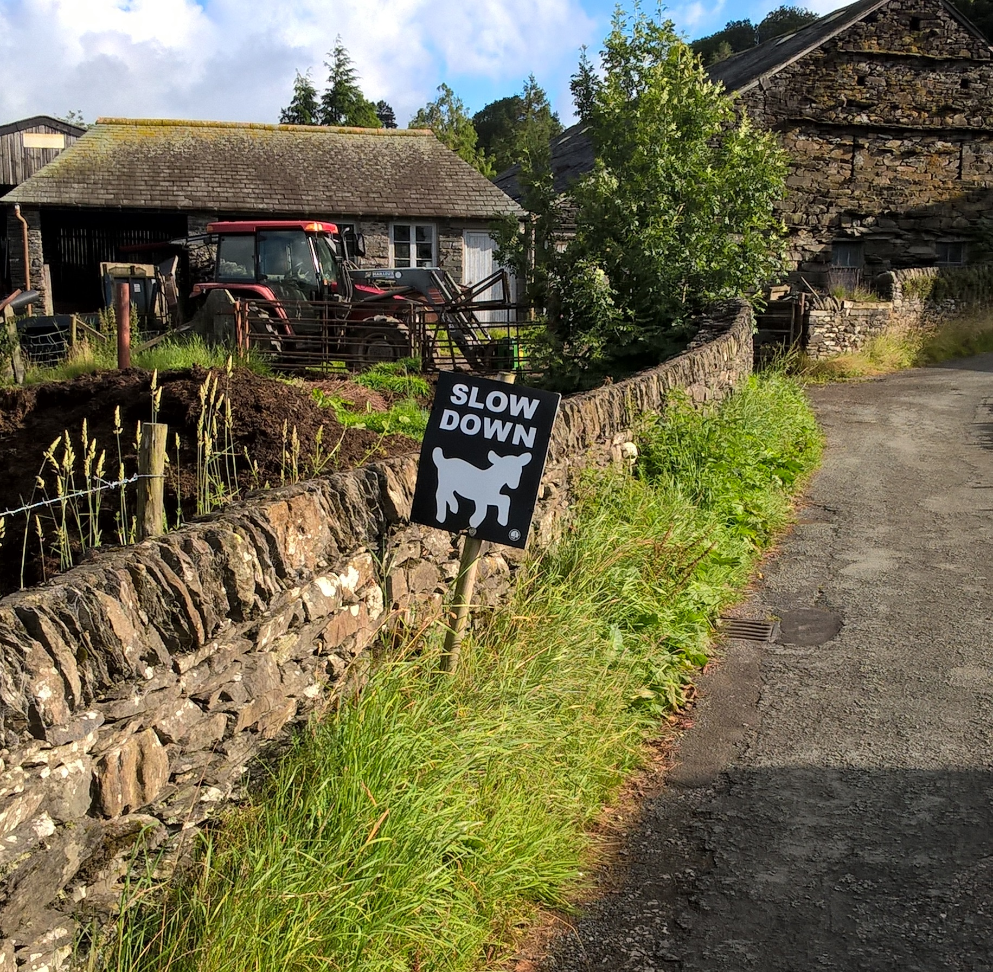
Our Process
Write a little bit of code
Download it (“Flash”)
See what it does
Repeat
Notes:
Where Scratch hid a lot of complexity behind snap together lego pieces, we
are going to be writing closer to actual instructions.
Where Scratch was interpreting our commands "live" and we could make changes that were instantly reflected in the behaviour of the program, Micro Python is a compiled language and follows a different lifecycle. We write code in text, we send the code down to the device where it is compiled into it's own internal representation, then the program executes.
This is faster to run and only needs to be downloaded once for each version, but it's not as reactive and live as Scratch.

Slide 36
Let’s get connected
Notes:
Plug cable into usb and plug other end into the port on the board. Don’t worry about touching it, you won’t get a shock and you won’t break anything.
The lead gives the unit power so keep it connected at all times.
Things to note - the display on one side. Two buttons left and right are a and b. The connector on the back and next to it a reset button. If everything is going wrong you can press that to restart your program.

Slide 37
micro:bit functions
from microbit import *

Slide 38
Smallest Possible Program
from microbit import *
display.scroll('hello')
Notes:
be careful of spelling, case, punctuation and spacing (indenting) Flash and watch yellow light. Program starts immediately

Slide 40
Larger Program
from microbit import *
# variable
greeting = ‘hi’
display.scroll(greeting)
Notes:
Change the greeting and re-flash
Contrived example to show variable - could be read from a keyboard or from internet or something.

Slide 41
Variables?
# variable
temperature = read_temp()
display.scroll(str(temperature))
Notes:
We can read the temp from outside without having to change the program, temperature is a placeholder for a value. We use that name in place of having to write 100 or 50 or whatever.

Slide 42
from microbit import *
greeting = ‘hi’ # more
name = ‘derek’ # variables
age = 19
display.scroll(greeting)
display.scroll(“My name is”)
display.scroll(name)
display.scroll(“I am”)
display.scroll(str(age))
Notes:
Change the greeting and re-flash

Slide 43
Another Program
display.show(Image.HAPPY)
sleep(5000)
display.show(Image.ASLEEP)
Notes:
Delays
Pre-built images. List is quite long, try some different ones.

Slide 44
A few times…
# do it 3 times
for times in range(0, 3):
display.show(Image.HAPPY)
sleep(1000)
display.show(Image.ASLEEP)
sleep(1000)
display.scroll(‘done’)
Notes:
Notice indenting and does loop 3 times. Colon at the end of for

Slide 45
Forever
while True:
display.show(Image.HAPPY)
sleep(1000)
display.show(Image.ASLEEP)
sleep(1000)
display.scroll(‘done’)
Notes:
Notice indenting, colon and never comes back from this loop.
True is a proper name, must be this case.
Code put at the end of the loop never executes

Slide 46
Acclerometer

Slide 47
Accelerometer
x_tilt = accelerometer.get_x()
y_tilt = accelerometer.get_y()
# all on one line…
display.scroll(“x: “ + str(x_tilt)
+ “y: “ + str(y_tilt))
Notes:
Str convert value to string to be able to display

Slide 49
Cyber-Pet
from microbit import *
# Shake to wake your pet up
while True:
if accelerometer.was_gesture("shake"):
display.show(Image.HAPPY)
sleep(5000)
else:
display.show(Image.ASLEEP)
Notes:
Notice if and colon and else and colon
Could also have elif:
# try ‘face up’ or ‘face down’

Slide 50
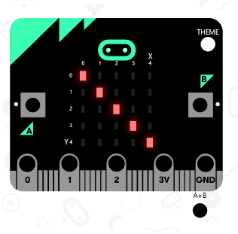
Notes:
Now let's wait for a few seconds then turn the lights off again. We go to the basic
section again and drag on a pause block. Let's click in the box and change the 100 to 500
(half a second).

Slide 51
Your Image?
smiley = Image(
“00000:"
“09090:"
“00000:"
“90009:"
“09990")
display.show(smiley)
Notes:
Custom images, brightness and shades of grey. Colons are important. Make your own picture.

Slide 52
Buttons
from microbit import *
while True:
if button_a.was_pressed():
display.scroll('A')
elif button_b.was_pressed():
display.scroll('B')
sleep(100)
Notes:
is_pressed vs was_pressed? timing
Note extra indenting - two levels here.

Slide 53
Notes:
Including everything makes for big programs, need to be selective and use only what we need. Import

Slide 54
Randomness
import random
words = [‘one’, ‘two’, ‘three’]
word = random.choice(words)
display.scroll(word)
Notes:
Import random - not used otherwise
List, picks one of a list. [ in pairs ] list comma delimited. Can change content of words but without having to change the rest of the program.

Slide 55
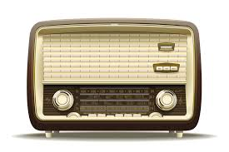
Notes:
Radio is one of the most fun parts of the microbic

Slide 56
Radio
import radio
radio.on()
to_send = “hello”
while True:
if button_a.was_pressed():
radio.send(to_send)
received = radio.receive()
if received:
display.scroll(received)
Notes:
Radio is expensive, turn on when necessary. Send broadcasts to local area and receive receives from any one. Must check message before using.

Slide 57
Notes:
Can do simple animation on the display in a number of different ways.
Each frame is structured in a list to make it look like movement. We can do the same thing…

Slide 58
from microbit import *
small_heart = Image (“00000:05550:05650:05550:00000:")
big_heart = Image (“09090:99999:99999:09990:00900:")
heartbeat = [
small_heart,
big_heart,
small_heart,
big_heart,
small_heart,
small_heart
]
display.show(heartbeat, loop=True, delay=250)
Notes:
An example I made for my wife… list of images and display cycles through them, loop and delay between each frame

Slide 60
Functions
def say_something():
display.scroll(‘hi’)
say_something()
Notes:
Reusable chunks of code
Must come first before being used so python sees them and puts them away
Arguments
Return values

Slide 61
Functions
def say_something(message):
display.scroll(message)
say_something(‘hey’)
say_something(‘hi’)
say_something(‘hello’)
Notes:
Reusable chunks of code
Arguments
Return values

Slide 62
Functions
def is_it_bob(name):
return name == “bob”
if is_it_bob(person_name):
display.scroll(‘hi bob’)
Notes:
Reusable chunks of code
Arguments
Return values

Slide 63
Cheat Sheet
Notes:
Cheat sheet has example of most things here so you can get syntax right…

Slide 64
Questions
Notes:
I’ll stop blathering now and stop for questions.

Slide 65
Break?

Slide 67
Write a Program
Find a partner (or two)
Pick an activity sheet
…or use your own idea
Build & Test it
Extend it
Explain it
Notes:
Talk about how it went, what you built, how you built it, what was easy, what was hard.

Slide 69
Break?

Slide 70
Write a program for another team
Find a team
Pick an activity sheet
…or use your idea
Build & Test
Swap
Notes:
Then we will talk about it at the end

Slide 72
Notes:
Skills. IOS, web apps whatever. Microbit and algorithms, debugging etc. are transferable.

Slide 73
Notes:
Technology changes with fashion, principles do not. Same skills Margaret Hamilton used are what we have used today but computer could not be more different.

Slide 74
so…
Notes:
This is a relatively new hardware platform - a tiny board (a bit like the raspberry pi) but
with bluetooth, compass, tiny display, accelerometer.

Slide 75
what
will you make next?
Notes:
This is a relatively new hardware platform - a tiny board (a bit like the raspberry pi) but
with bluetooth, compass, tiny display, accelerometer.

Slide 76
